Slide 1
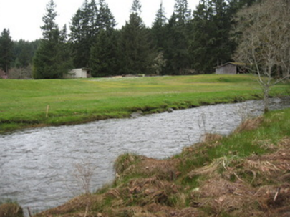
Mason Voluntary Stewardship Program
Where critical areas &
agriculture meet
VSP Work Group Meeting
February 28, 2017

Slide 2
VSP Purpose Reminder
Ensure the viability of agriculture and reduce the conversion of farmland to other uses
Protect baseline conditions for critical areas measured on a watershed scale as of July 2011
Enhance critical areas measured on a watershed scale through voluntary actions
Agriculture Critical Areas

Slide 3
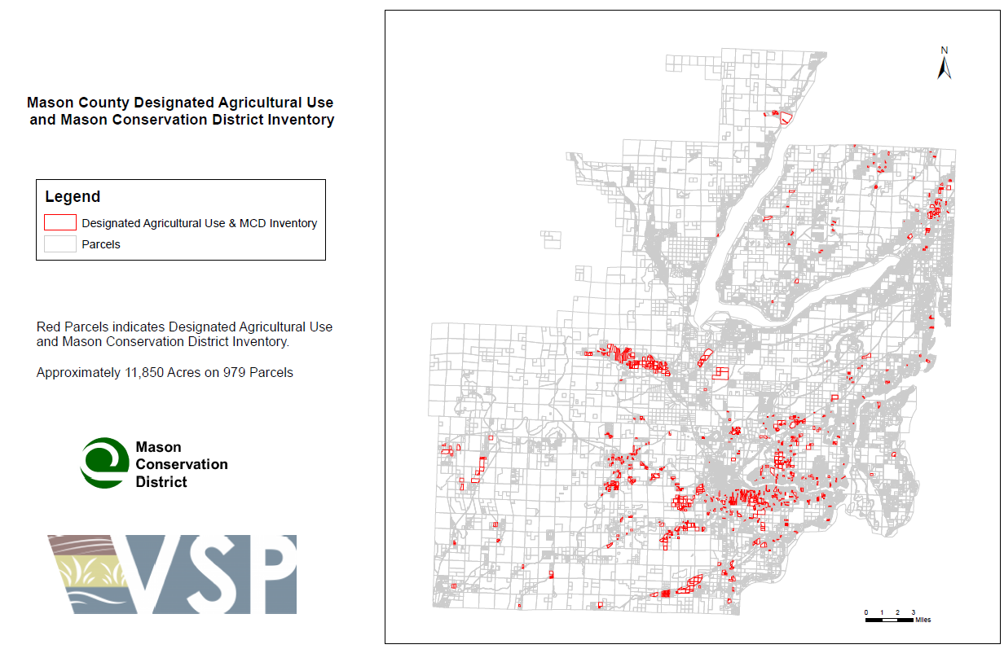
Agriculture in
Mason County

Slide 4
GMA Critical Areas in Mason County
Wetlands
Frequently Flooded Areas
Geologically Hazardous Areas
Aquifer Recharge Areas for Potable Water Supply
Fish and Wildlife Habitat Conservation Areas
Many critical areas make the best farmland!
Our focus is where farmland and critical areas meet

Slide 5
Work Plan Conceptual Model
How the Work Plan will approach intersection of ag lands with critical areas

Slide 6

What is a wetland under GMA?
…Areas that are inundated or saturated by surface water or groundwater at a frequency and duration sufficient to support, and that under normal circumstances do support, a prevalence of vegetation typically adapted for life in saturated soil conditions. Wetlands generally include swamps, marshes, bogs, and similar areas.

Slide 7
What is a wetland under GMA?
Wetlands do not include those artificial wetlands intentionally created from nonwetland sites, including, but not limited to, irrigation and drainage ditches, grass-lined swales, canals, detention facilities, wastewater treatment facilities, farm ponds, and landscape amenities, or those wetlands created after July 1, 1990, that were unintentionally created as a result of the construction of a road, street, or highway.
Wetlands may include those artificial wetlands intentionally created from nonwetland areas created to mitigate conversion of wetlands.

Slide 8
In simpler terms…
Predominance of hydric soils
Inundated or saturated at frequency & duration sufficient to support plant life adapted to this condition

Slide 9
And don’t forget federal jurisdiction!
US Army Corps of Engineers
US Environmental Protection Agency
NRCS
"Wetlands are areas that are inundated or saturated by surface or ground water at a frequency and duration sufficient to support, and that under normal circumstances do support, a prevalence of vegetation typically adapted for life in saturated soil conditions. Wetlands generally include swamps, marshes, bogs, and similar areas."
Definition of wetlands as used by the U.S. Army Corps of Engineers (Corps) and the U.S. Environmental Protection Agency (EPA) since the 1970s for regulatory purposes.

Slide 10
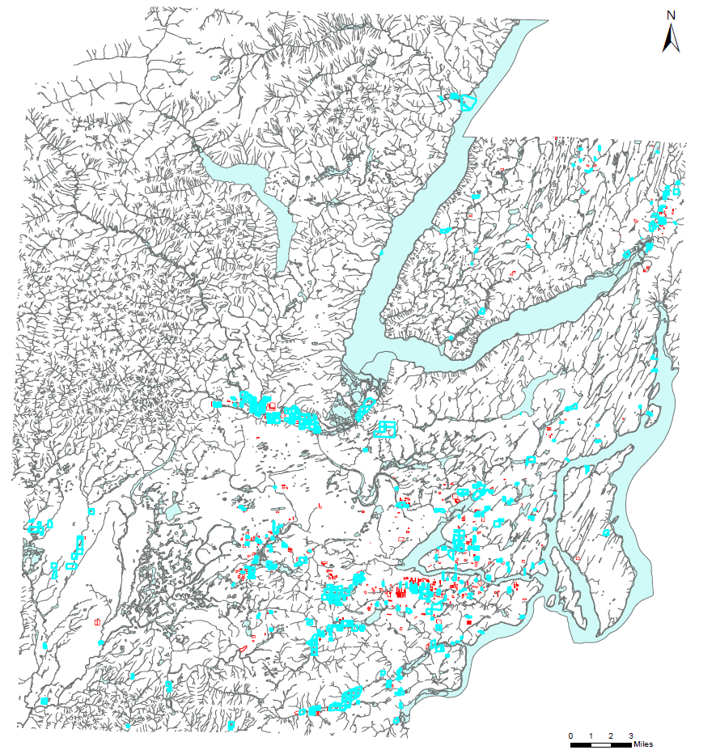
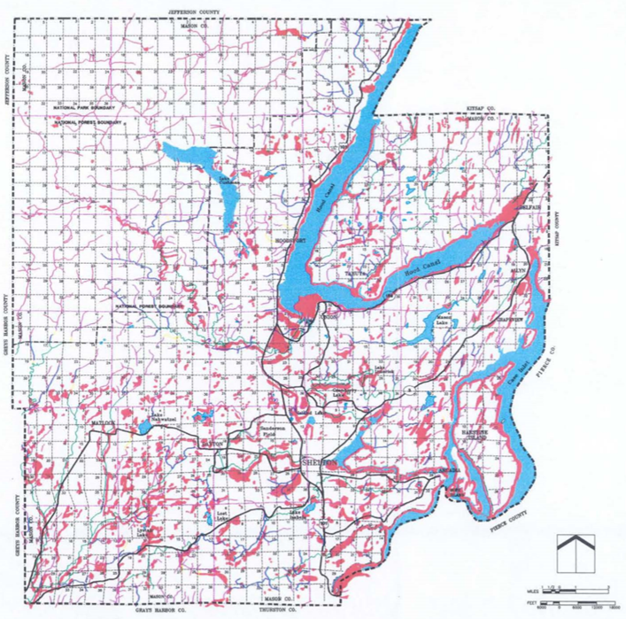
Wetlands in Mason County
Wetlands on Ag Lands

Slide 11
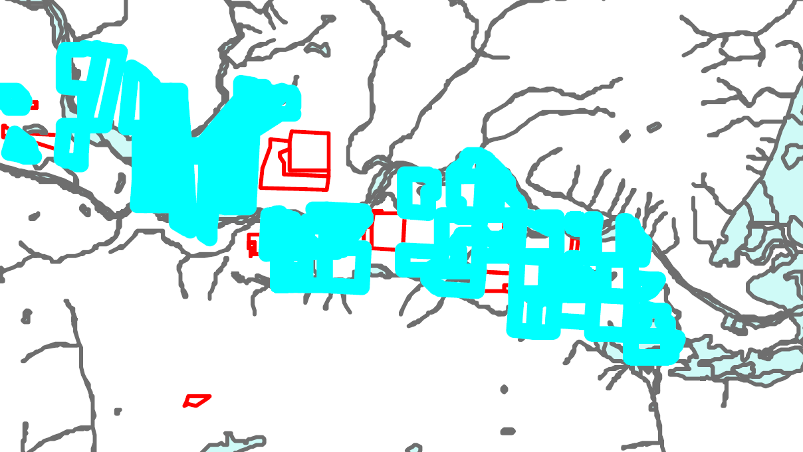
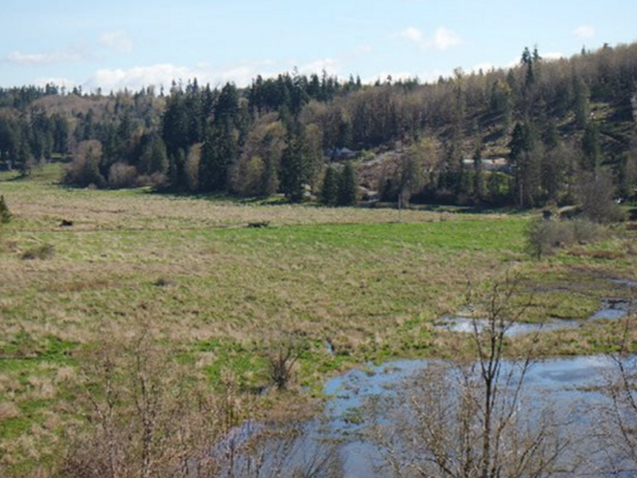
Wetlands on Agricultural Lands in Mason County
Acres of ag lands affected by wetlands: ± 10,266
Number of ag parcels with wetlands: ± 521
Percent of all ag lands with wetlands: ±76%

Slide 12
What thoughts or concerns can you share about wetlands on agricultural land?

Slide 13
Critical Area Talk: Functions and Values
Functions – the “role” or “job” a critical area performs in the environment
  Example – wetlands collect & store water
Values – the “benefits” a critical area performs for the environment, public, and your farm
  Example – replenish aquifers & streams during the dry season

Slide 14
Wetland functions can contribute to agricultural viability
Surface water storage
  Prevents flooding by storing floodwaters
  Filters nutrients, pesticides, bacteria from entering streams
  Reduces erosion by slowing runoff
Subsurface water storage
  Replenish water levels in aquifers & streams, especially during dry season when irrigation is important
  Retains moisture in surrounding soils

Slide 15
Wetland functions can contribute to agricultural viability
Nutrient cycling
  Aids in decomposing organic matter
Shoreline stabilization
  Dissipates stream energy during high flows
Fish & wildlife habitat
  Provides harvestable plant & animal species
  Provides natural pest management
!
Not all wetlands perform all functions nor do they perform all functions equally well.

Slide 16
How can we enhance the function of wetlands on agricultural lands?
Best Management Practices (BMPs)
  Methods for agriculture to protect the environment and increase productivity
  In and around a wetland, use of technology
  Working lands v. land retirement BMPs
  BMPs voluntarily adopted after careful thought
  Outreach is critical

Slide 17
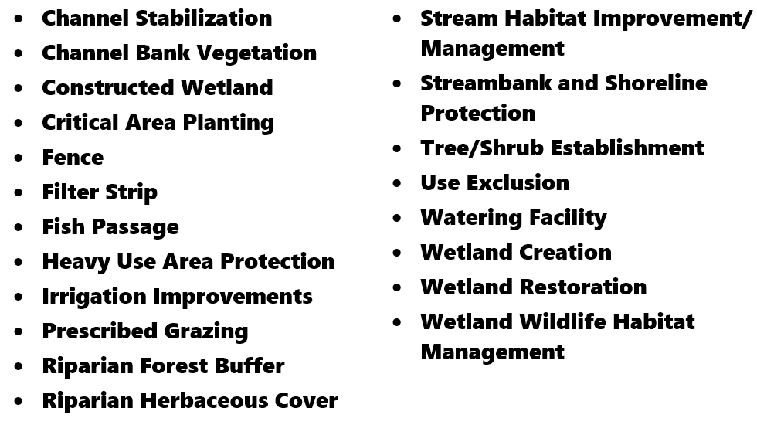
BMPs most commonly associated with wetlands

Slide 18
Other approaches associated with wetlands
Removing marginal lands out of production & into conservation programs that provides annual rental payments
  Agricultural Conservation Easement Program / Wetland Reserve Easement (ACEP)
  Conservation Reserve Program (CRP)
  Environmental Quality Incentives Program (EQIP)
Mitigation
Land retirement approaches can impact the long-term viability of agriculture in county. If used, it will be important to off-set this impact through increased productivity.
!

Slide 19
Are there BMPs or approaches we should avoid?
Are there conservation practices we should encourage that are not listed?

