Slide 1
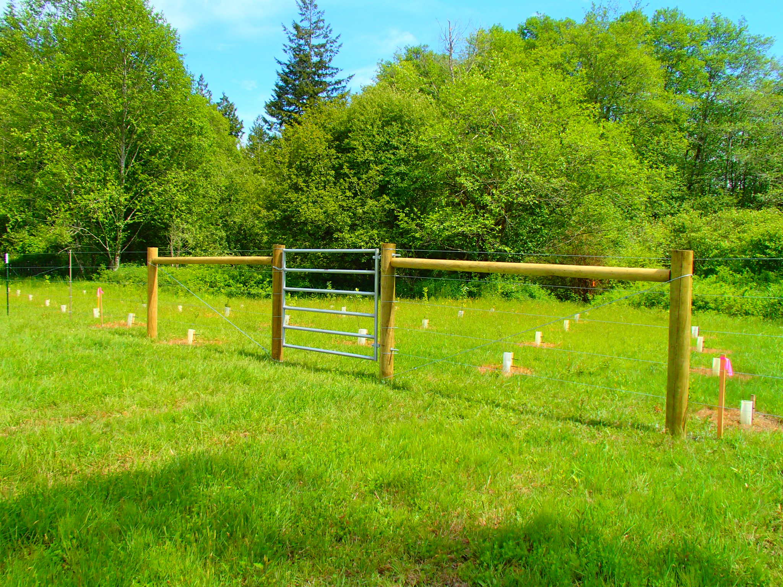
Best Management Practices Commonly used in Mason County
Mason Conservation District

Slide 2
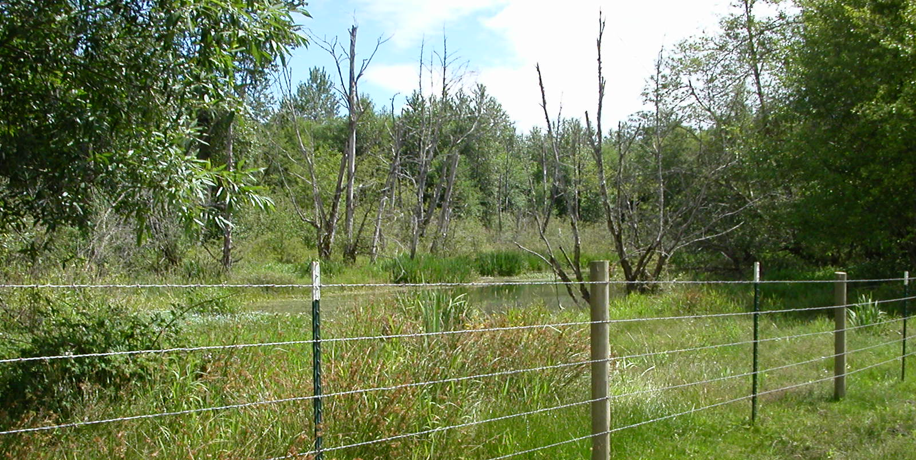
Exclusion Fence

Slide 3
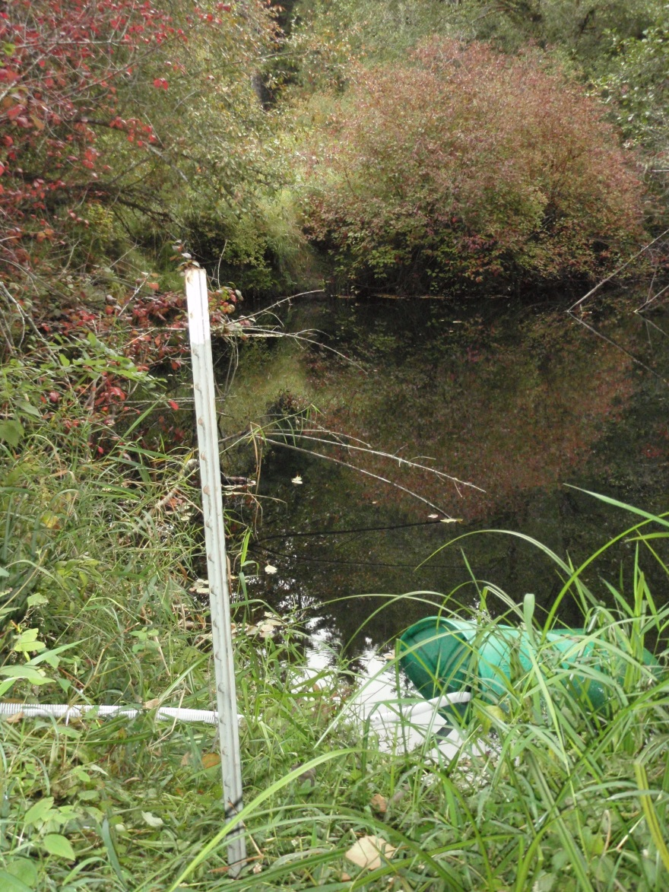
Watering Facility
Notes:
Off stream watering to prevent animals in creek
Protects stream buffer plantings
Heavy use area around watering facility to prevent mud

Slide 4
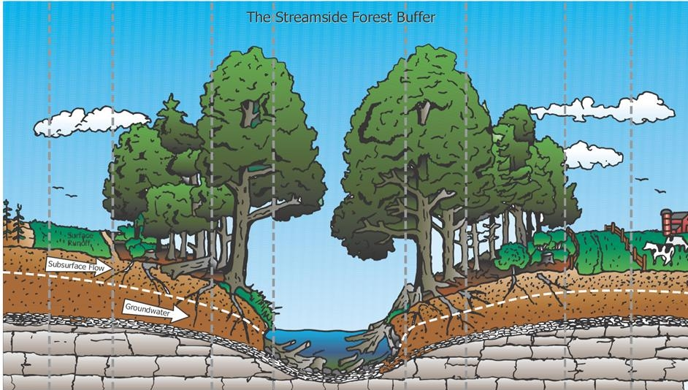
Riparian Forest Buffer

Slide 5
Critical Area Planting

Slide 6
Hedgerow Planting

Slide 7
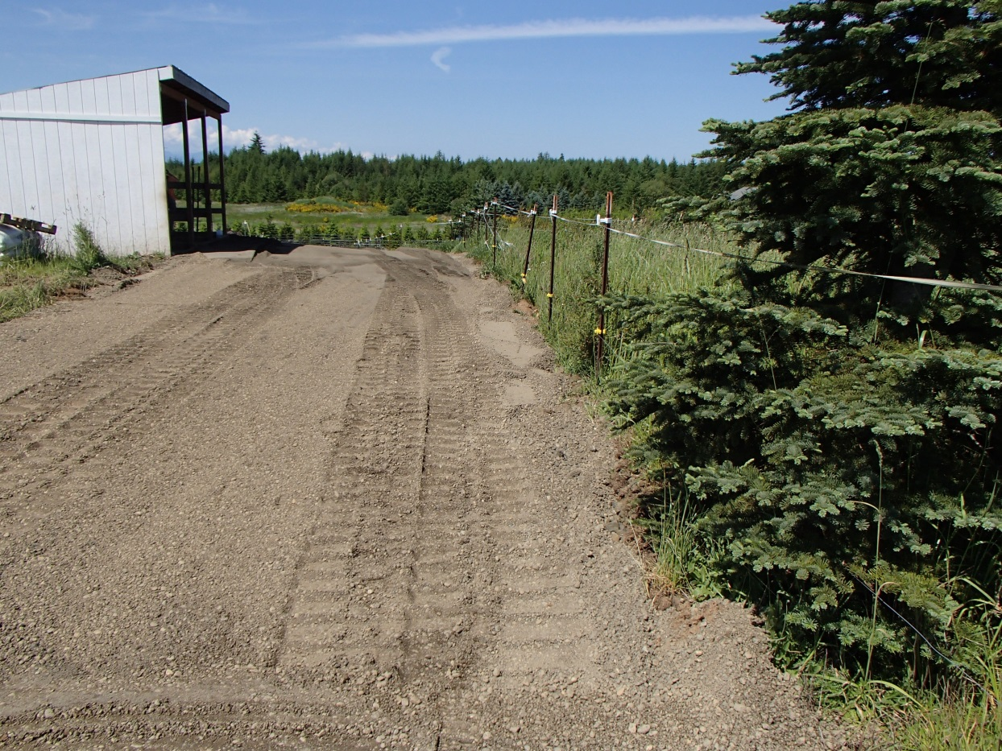
Heavy Use Area Protection

Slide 8
Heavy Use Area Protection

Slide 9
Heavy Use Area Protection

Slide 10
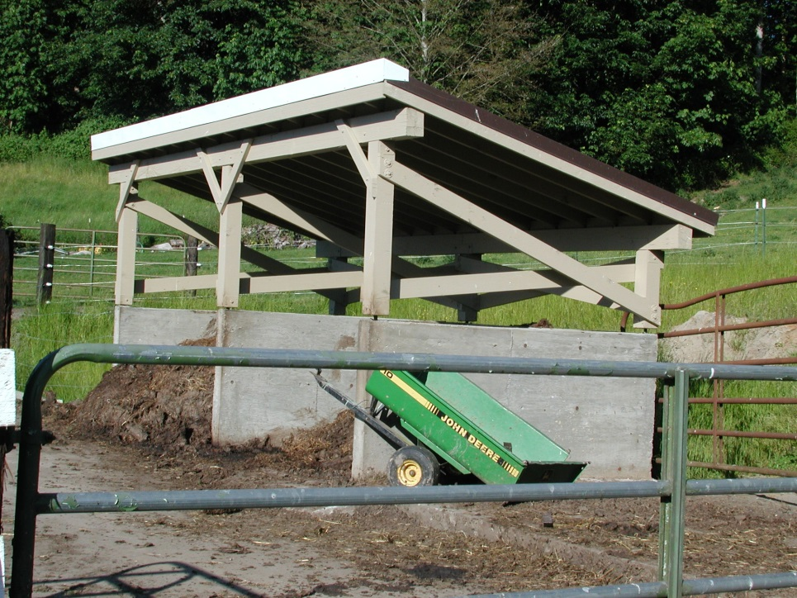
Waste Storage Structure
Composting Facility

Slide 11
Composting Facility

Slide 12
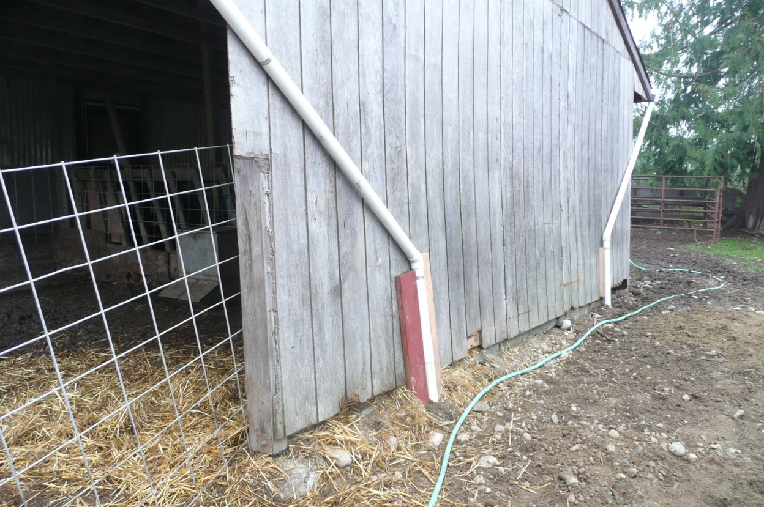
Roof Runoff Structure

Slide 13
Subsurface Drain

Slide 14
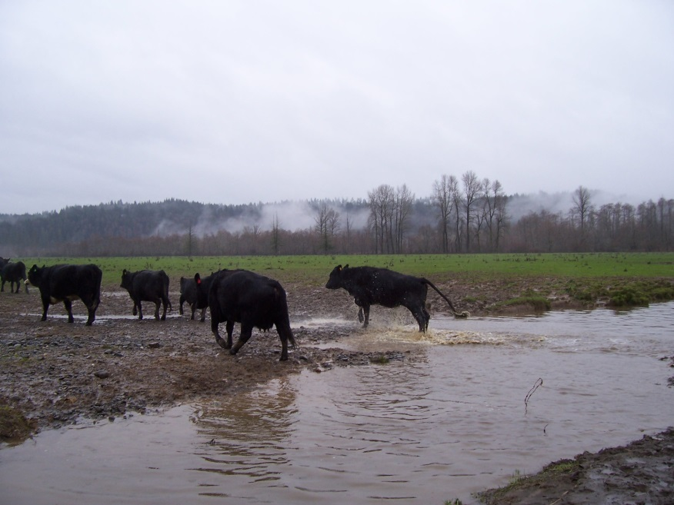
Stream Crossing

Slide 15
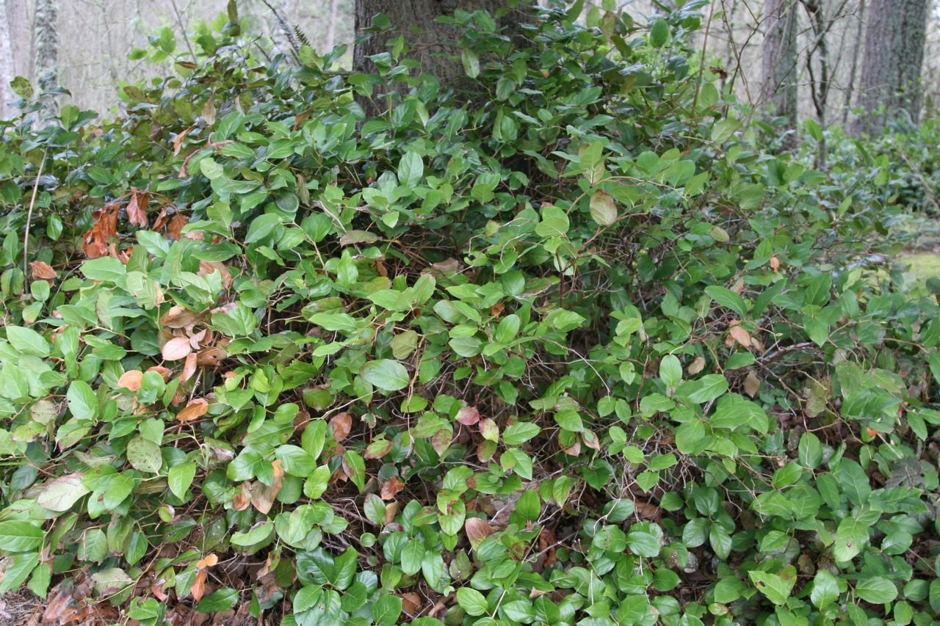
Multi-Story Cropping

Slide 16
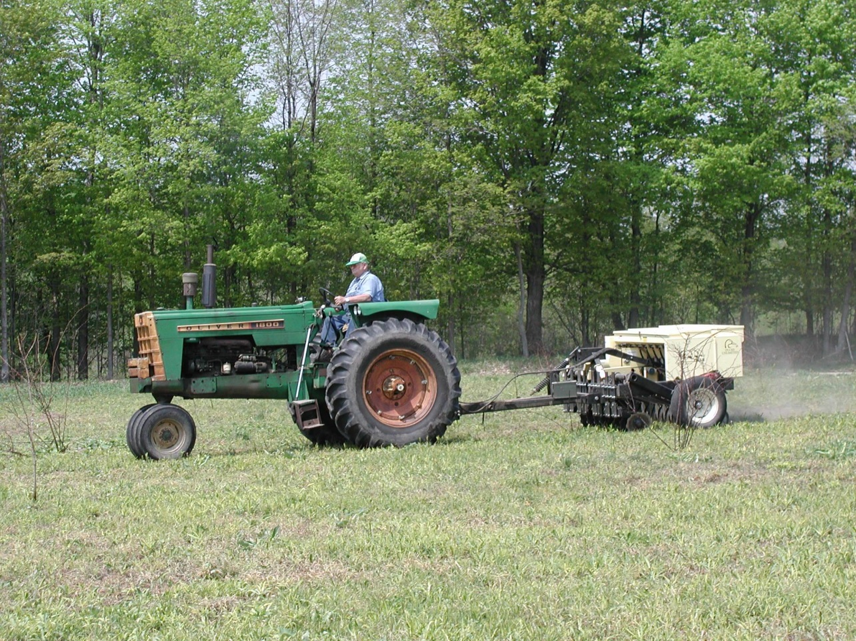
Pasture and Hay Planting

Slide 17
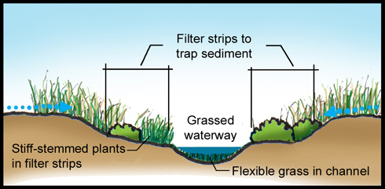
Drainage Improvements Grassed Waterway

Slide 18
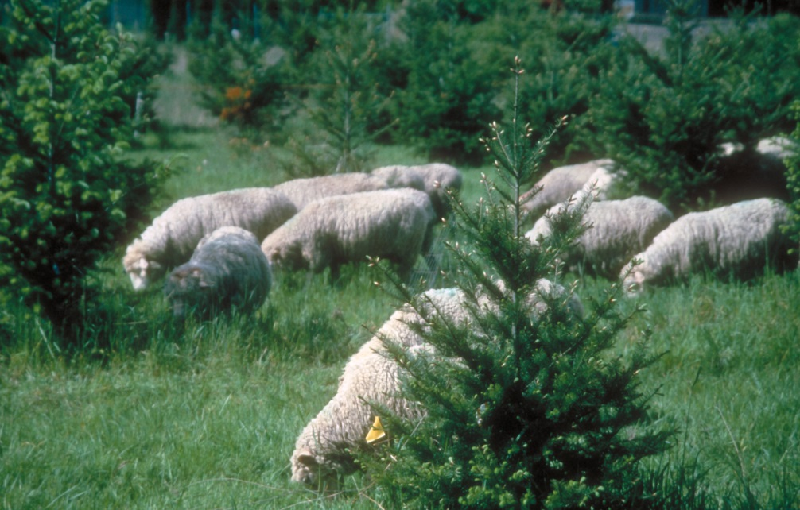
Silvo-pasture Establishment

Slide 19
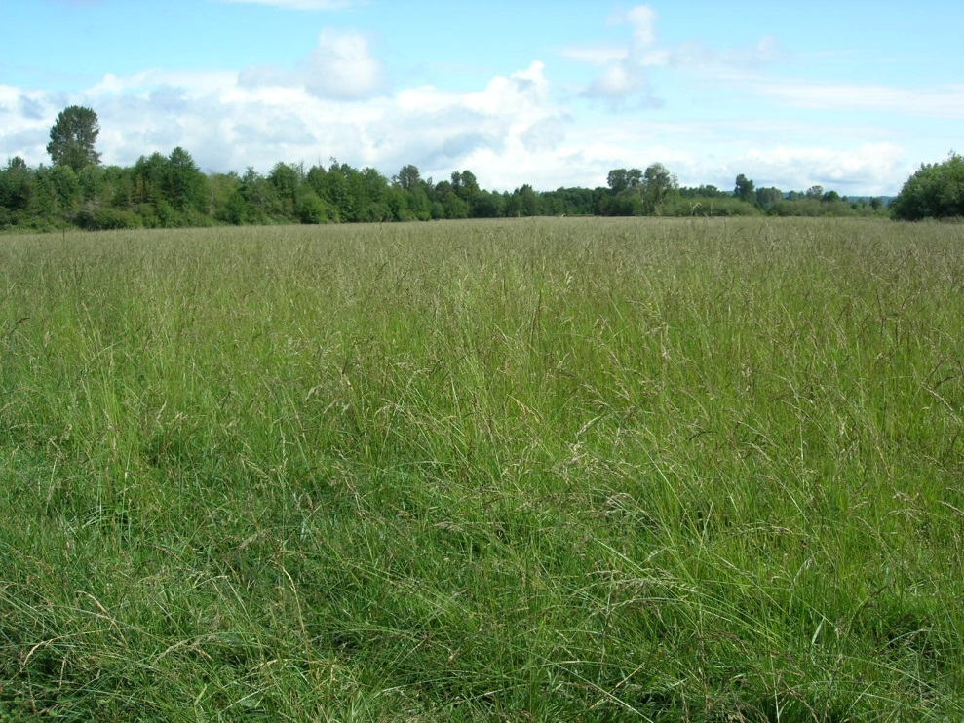
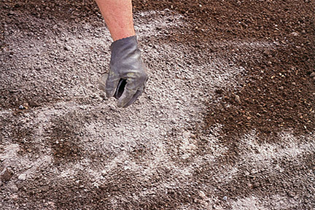
Nutrient Management Plan

Slide 20
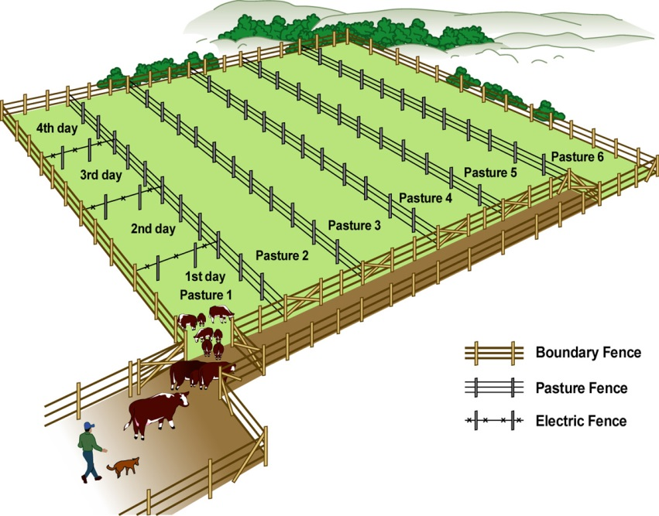
Cross Fence

Slide 21
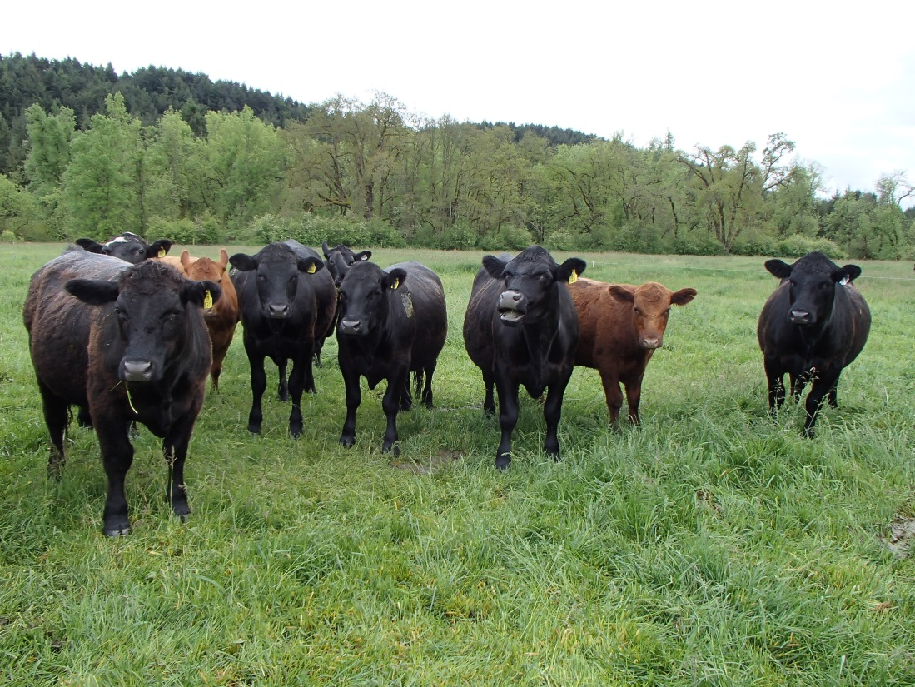
Prescribed Grazing

