Slide 1
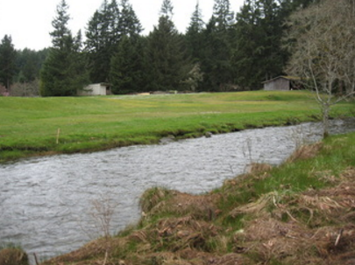
Mason Voluntary Stewardship
VSP Work Group
January 24, 2017

Slide 2
Tonight’s Agenda
Quick overview of agriculture in Mason County
What can you share about the status of agriculture in Mason County? SWOT analysis
Selection of chair
Next meeting date

Slide 3
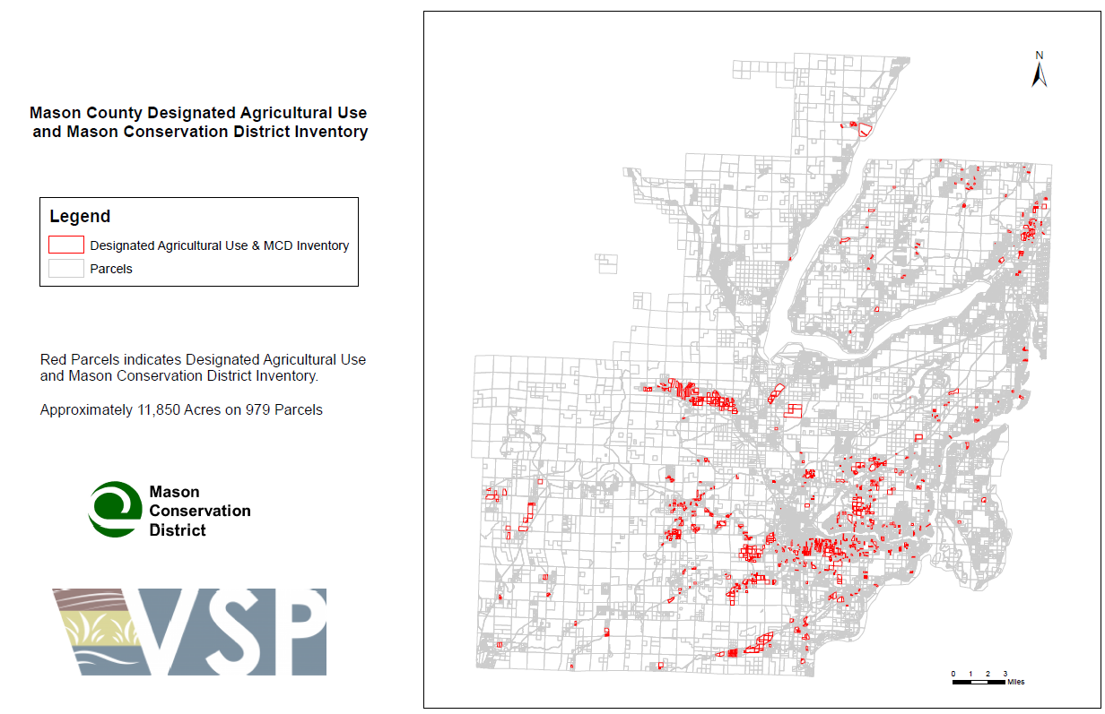
Overview of Agriculture in Mason County

Slide 4
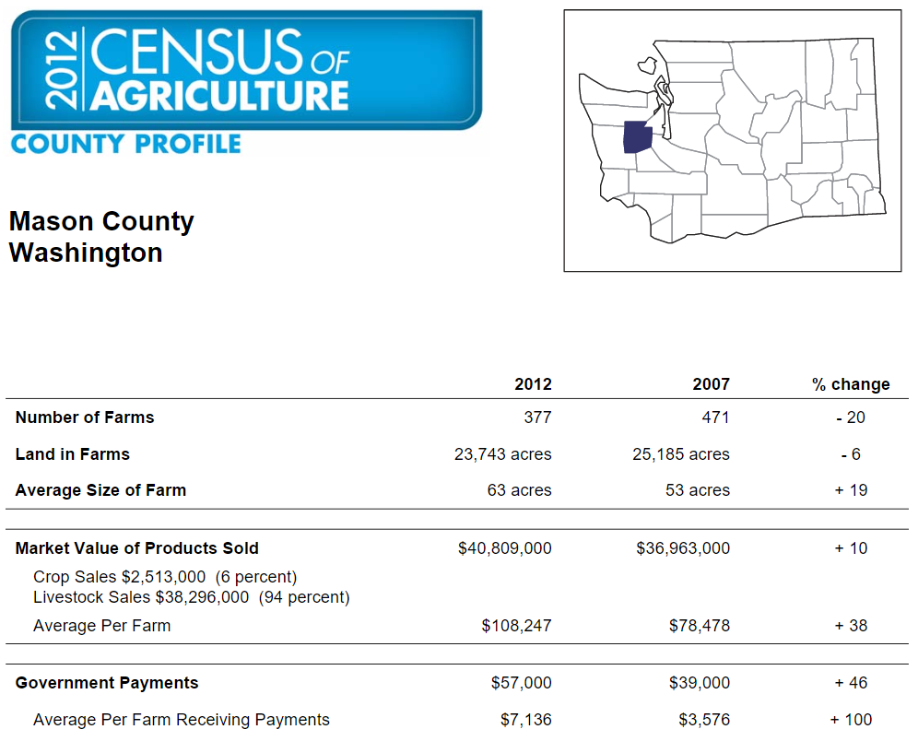
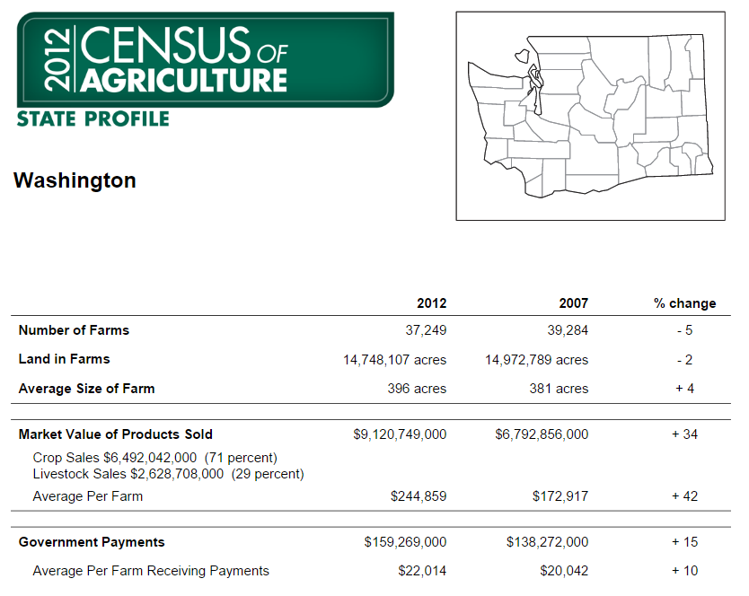
Overview of Agriculture in Mason County

Slide 5
Overview of Agriculture in Mason County

Slide 6
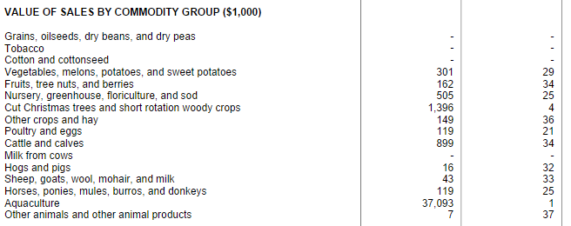
Overview of Agriculture in Mason County

Slide 7
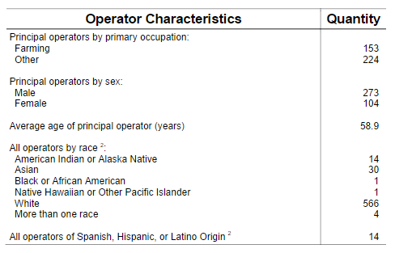
Overview of Agriculture in Mason County

Slide 8
Reminder about general purpose of VSP…
Protect & enhance critical areas within agricultural lands while maintaining & improving long-term viability of agriculture
Reduce the conversion of farmland to other uses
Includes commercial and noncommercial agriculture

Slide 9
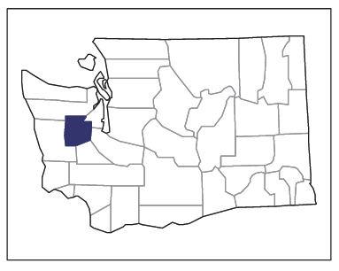
What can you share about the status of agriculture in Mason County? SWOT Analysis!
SWOT analysis helps understand current conditions
STRENGTHS are those factors within Mason County that could enhance the future viability of agriculture and reduce the conversion of farmland to other uses
WEAKNESSES are those factors within Mason County that could hinder the future viability of agriculture and reduce the conversion of farmland to other uses
IN OUR COUNTY

Slide 10
SWOT Analysis!
OPPORTUNITIES are those factors outside Mason County that could enhance the future viability of agriculture and reduce the conversion of farmland to other uses
THREATS are those factors outside Mason County that could hinder the future viability of agriculture and reduce the conversion of farmland to other uses
STATE
NATION
WORLD

Slide 11
Reminder about general purpose of VSP…
Take five minutes to individually fill out the SWOT Analysis sheet
Round-robin sharing of SWOT thoughts

