Slide 1
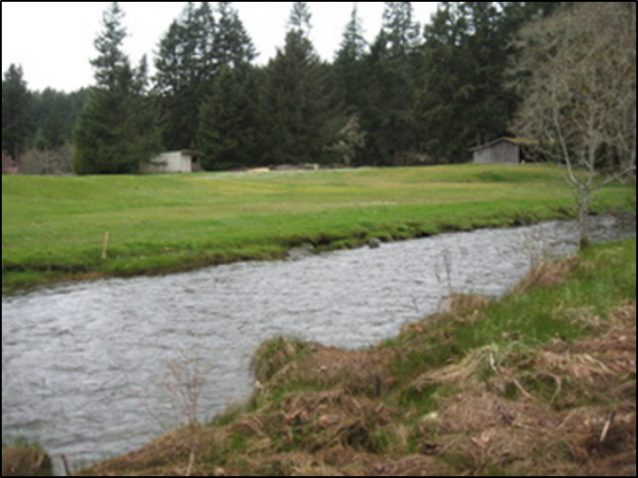
Mason Voluntary Stewardship Program
Where critical areas &
agriculture meet
VSP Work Group Meeting
May 23, 2017

Slide 2
Agenda
Frequently flooded areas
Geologically hazardous areas
Fish & wildlife habitat conservation areas (FWHCAs)

Slide 3
Working Conceptual Framework
Mason County VSP Goals
Ensure the viability of agriculture and reduce the conversion of farmland to other uses
Protect baseline conditions for critical areas measured on a watershed scale as of July 2011
Enhance critical areas measured on a watershed scale through voluntary actions

Slide 4
Working Conceptual Framework
Three goals implemented through four tracks:
Individual Stewardship Plans (ISP)
VSP Work Plan Outreach
Monitoring VSP Progress
Program Maintenance

Slide 5
Intersection of Frequently Flooded Areas and Agriculture

Slide 6
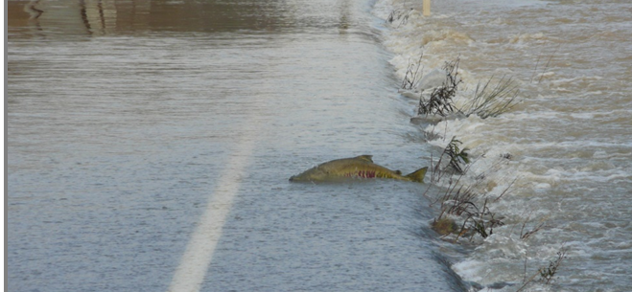
What is a frequently flooded area under GMA?
“(L)ands in the flood plain subject to at least a one percent or greater chance of flooding in any given year, or within areas subject to flooding due to high groundwater. These areas include, but are not limited to, streams, rivers, lakes, coastal areas, wetlands, and areas where high groundwater forms ponds on the ground surface.”
Retaining agriculture as open space is beneficial to frequently flooded critical areas

Slide 7
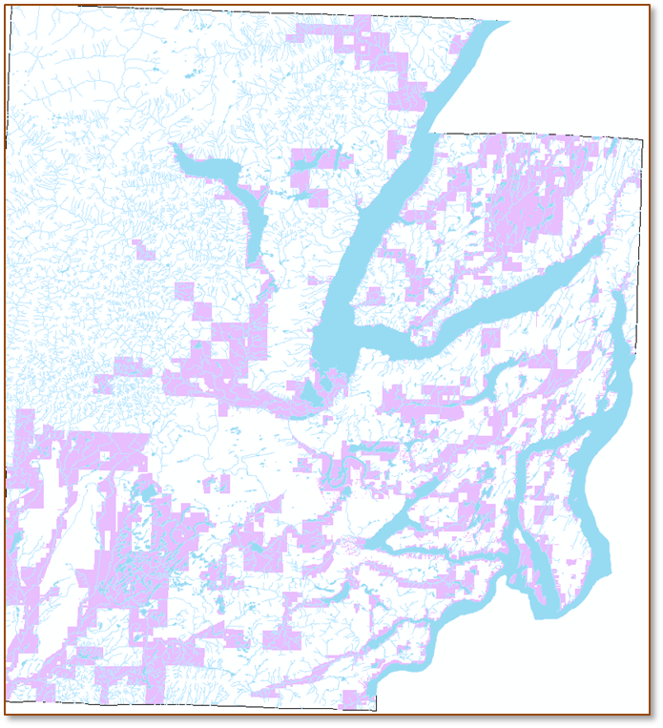
Frequently flooded areas in the county
Prevalent to ag lands in county drainages
Use FEMA FIRM maps to identify intersection with ag lands

Slide 8
Frequently flooded concerns for agriculture
Damage to property/safety of people & livestock
Expansion of flood area and duration, especially from other uses and public infrastructure
Increased flood velocities; soil loss/bank erosion
Deposition of flood-borne debris on ag lands
Decreased property values
Other?

Slide 9
ISP Strategies for Frequently Flooded Critical Areas
Retain / increase agricultural lands
Improve floodwater filtration
Reduce floodwater velocities
Protect farm structures, crops, & livestock
Other?

Slide 10
Sample ISP conservation practices for frequently flooded areas:
Agricultural land preservation* | Conservation crop rotation*
Cover crop | Dam*
Direct seed* | Filter strips
Grassed waterways | Livestock & equipment pads*
Mulch tillage* | Ponds*
Riparian forest buffer | Riparian herbaceous cover
Rock barrier* | Stream habitat improvement*
Tree & shrub establishment | Water harvesting catchment*
Watering spreading | Wetland creation, enhancement, restoration*
Other?

Slide 11
Intersection of Geologically Hazardous Areas and Agriculture

Slide 12
What is a geologically hazardous area under GMA?
Geologically hazardous areas are areas that because of their susceptibility to erosion, sliding, earthquake, or other geological events, are not suited to siting commercial, residential, or industrial development consistent with public health or safety concerns.

Slide 13
Most common geologic hazards to farms:
Erosion hazard areas are those areas containing soils which, according to the United States Department of Agriculture Natural Resources Conservation Service Soil Survey Program, may experience significant erosion. Erosion hazard areas also include coastal erosion-prone areas and channel migration zones.
Seismic hazard areas are areas subject to severe risk of damage as a result of earthquake induced ground shaking, slope failure, settlement, soil liquefaction, debris flows, lahars, or tsunamis.
Landslide hazard areas are areas at risk of mass movement due to a combination of geologic, topographic, and hydrologic factors.

Slide 14
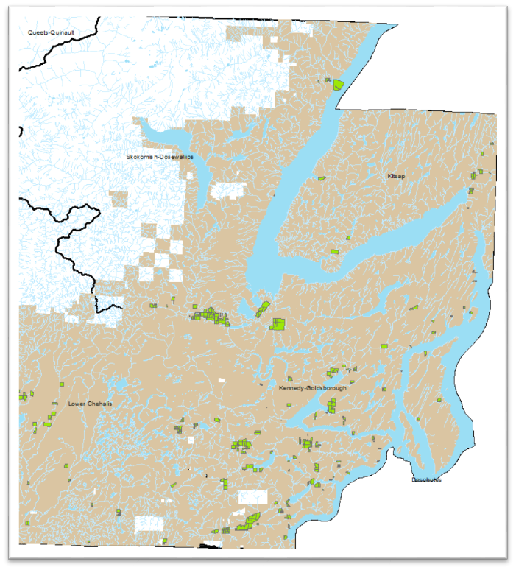
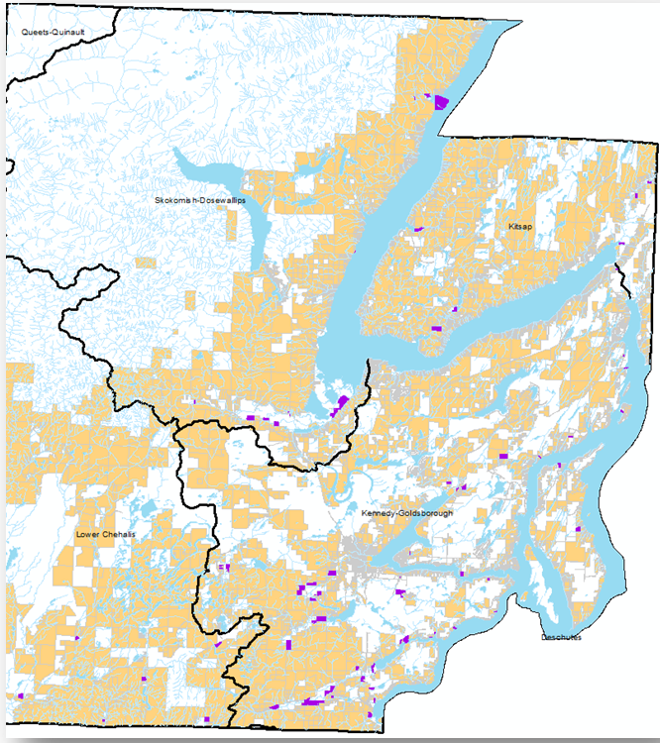
Geologically hazardous areas in the county
Seismic, landslide, and channel migration are the main hazards
Earthquake
Landslide

Slide 15
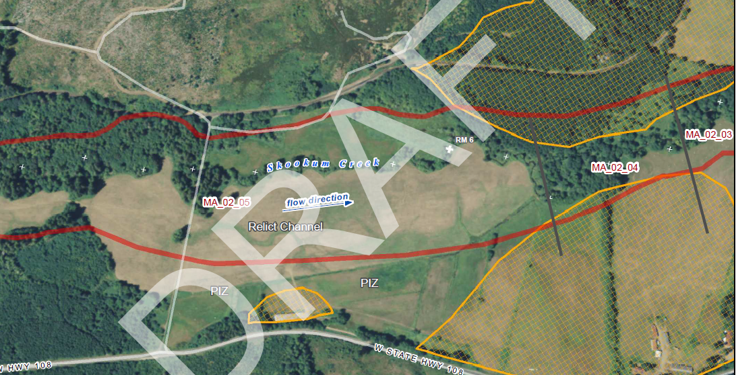
Channel Migration Zones (CZM)

Slide 16
Geologic hazard concerns for agriculture
Damage to property / safety of people & livestock
Soil loss from sheet or bank erosion
Migration of streams through fields
Landslide unto crops / structure
Other?

Slide 17
ISP Strategies for Geologically Hazardous Areas
Retain / increase agricultural lands
Reduce bank erosion & channel migration
Minimize erosion & sedimentation
Reduce landslide potential
Minimize earthquake risk
Other?

Slide 18
Sample ISP conservation practices for geologically hazardous areas:
Agricultural land preservation* | Channel bed stabilization*
Conservation cover | Conservation crop rotation*
Contour buffer strips & farming* | Cover crop
Direct seed* | Fencing
Grassed waterways | Heavy use area protection
Hedgerow planting | Mulching
Prescribed grazing | Range cover
Riparian forest buffer | Riparian herbaceous cover
Stream habitat improvement | Tree / shrub establishment
Water & sediment control basin* | Watering facility*
Info on earthquake risk* | Other?

Slide 19
Intersection of Fish & Wildlife Habitat Conservation Areas (FWHCA) and Agriculture

Slide 20
What are FWHCAs under GMA?
(L)and management for maintaining populations of species in suitable habitats within their natural geographic distribution so that the habitat available is sufficient to support viable populations over the long term and isolated subpopulations are not created. This does not mean maintaining all individuals of all species at all times, but it does mean not degrading or reducing populations or habitats so that they are no longer viable over the long term. Counties and cities should engage in cooperative planning and coordination to help assure long term population viability.

Slide 21
What are FWHCAs under GMA?
Areas where endangered, threatened, and sensitive species have a primary association
Naturally occurring ponds under twenty acres and their submerged aquatic beds that provide fish or wildlife habitat
Waters of the state
Lakes, ponds, streams, and rivers planted with game fish by a governmental or tribal entity
State natural area preserves, natural resource conservation areas, and state wildlife areas

Slide 22
FWHCA in the county
Mapped by WDFW Priority Habitats and Species
Fish, amphibians, reptiles, birds, mammals, invertebrates, and habitats
Most areas in the county have FWHCA of some kind
Salmon habitat is the most prominent of FWHCA
For many species, agriculture is extremely beneficial

Slide 23
FWHCA concerns for agriculture
Damage to cropland/safety of livestock
Regulatory impacts, especially state & federal listings
Uninvited trespass by people
Other?

Slide 24
ISP Strategies for FWHCAs
Retain / increase agricultural lands
Avoid disturbance to FWHCA
Enhance habitat
Reduce conflicts between agriculture & wildlife
Retain habitat
Other?

Slide 25
Sample ISP conservation practices for FWHCAs:
Agricultural land preservation* | Access control
Aquatic organism passage | Conservation cover
Conservation easements* | Critical area planting
Early successional habitat development & management | Fencing
Field border | Filter strips
Fish passage | Food plots*
Grassed waterways | Hedgerow plantings
Herbaceous weed treatment* | Integrated pest management*
Nuisance wildlife management* | Nutrient management

Slide 26
Sample ISP conservation practices for FWHCAs:
Open Space enrollment* | Riparian forest buffer
Stream habitat improvement | Structures for wildlife
Structure for wildlife | Tree / shrub establishment
Upland wildlife habitat | Watering facility
Wetland enhancement & restoration | Wildlife fencing*
Alley cropping*

