Slide 1

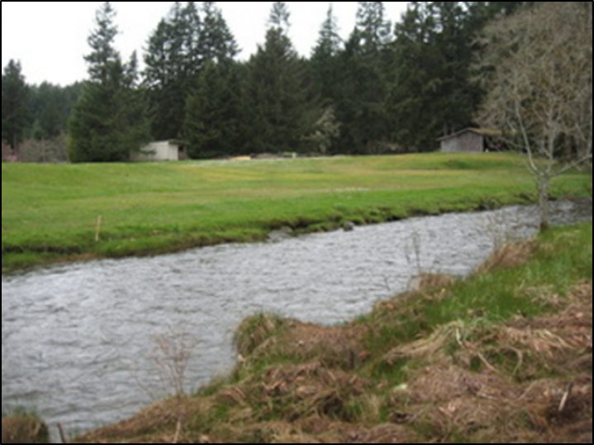
Mason Voluntary Stewardship Program
Where critical areas &
agriculture meet
VSP Work Group Meeting
April 25, 2017

Slide 2
Agenda
Discussion on Conceptual Framework
Focus on aquifer recharge areas

Slide 3
Work Plan Conceptual Model
How the Work Plan will approach intersection of ag lands with critical areas

Slide 4
Working Conceptual Framework
Skeleton VSP approach for Mason County
Keeping it super simple (KISS) in structure
Focus stays on ensure agricultural viability
Emphasizing the voluntary aspects of enhancement
Build a program that will become empowered through Work Group & participant leadership

Slide 5
Working Conceptual Framework
Mason County VSP Goals
  Ensure the viability of agriculture and reduce the conversion of farmland to other uses
  Protect baseline conditions for critical areas measured on a watershed scale as of July 2011
  Enhance critical areas measured on a watershed scale through voluntary actions

Slide 6
Working Conceptual Framework
Three goals implemented through four tracks:
  Individual Stewardship Plans
  VSP Work Plan Outreach
  Monitoring VSP Progress
  Program Maintenance

Slide 7
Working Conceptual Framework
Individual Stewardship Plans (ISP) – Core of the Program
CD as technical provider markets ISP to ag operators
Ag operators voluntarily agree to doing ISP
ISP identifies & addresses ag viability & critical area issues
ISP uses NRCS-based BMPs for enhancements; others as applicable

Slide 8
Working Conceptual Framework
Ag operator may fully or partially implement ISP with or without assistance (DIY)
CD periodically visits; advises, facilitates connection with other sources on request
ISP stays confidential – CD only keeps list of who has one

Slide 9
Working Conceptual Framework
VSP Outreach – Getting Farmers Involved
VSP Work Group is the “face” of the program with assistance from CD
Disseminates VSP info – literature, website, presentations
Work with community orgs & suppliers to connect with small noncommercial ag operators
Hold annual meetings, farm tours to explain program
Provide recognition for participating
Create ag mentorship program with enrolled participants

Slide 10
Working Conceptual Framework
Monitoring VSP Progress – Proving Success
CD collects ISP aggregate data on watershed scale and monitors 2011 baseline
Shares data with Work Group to analyze trends/progress
Work Group makes adjustments to VSP if necessary

Slide 11
Working Conceptual Framework
Program Maintenance – Keeping VSP Alive
Work Group gets & stays organized with structure
CD provides assistance, coordination with state, county
Partnerships with other VSP Work Groups, organizations

Slide 12
Intersection of Critical Aquifer Recharge Areas and Agriculture

Slide 13
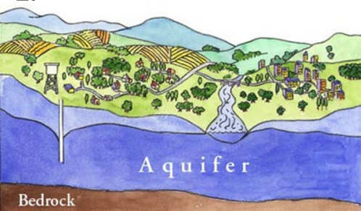
What is critical aquifer recharge area (CARA) under GMA?
“Critical aquifer recharge areas are areas with a critical recharging effect on aquifers used for potable water, including areas where an
aquifer that is a source of
drinking water is vulnerable
to contamination that would
affect the potability of the
water, or is susceptible to
reduced recharge.”

Slide 14
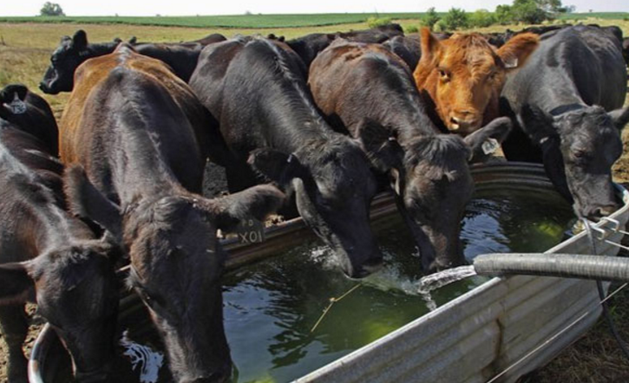
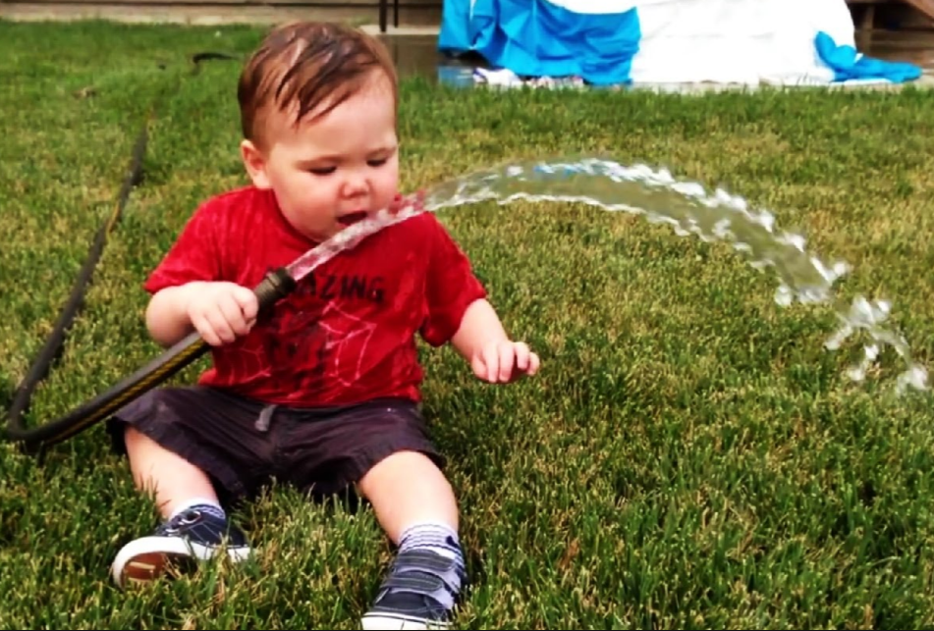
CARA provide potable water for
Individual wells for human & animal consumption
Small and large water systems
Fish and wildlife in streams and lakes

Slide 15
CARA on agricultural lands in Mason County
This reflects the GMA layer used in the county’s CAO…
Acres of ag lands affected by CARA: ≈3,700
Percent of all ag lands with CARA: ≈58%

Slide 16
CARA vulnerability
All land uses potentially can affect CARAs
Common agricultural activities that potentially can affect CARAs:
Animal burial areas | Animal feedlots/wastes
Fertilizer storage/use | Irrigation sites
Manure spreading areas/pits | Pesticide storage/use
High nitrate levels in groundwater (≥10 ppm)

Slide 17
Typical BMPs for CARAs:
Agricultural handling facility | Conservation crop rotation
Cover crop | Irrigation improvements
Irrigation water management | Manure transfer
Nutrient management | Prescribed grazing
Pest management | Residue & tillage
Water storage facility | Waste treatment
Waste utilization | Water well

